Slide 1
Introduction to C# and Unity
CT4026 – Games Engine Scripting

Slide 2
Introduction
Who are we?
What do we expect of you in this class?
What can you expect from us?

Slide 3
Games Engine Scripting - Module overview
30 CAT Module
Covering scripting/programming in the Unity engine
2 Assignments, one due 06th December 2019, one due 19th May 2020
First assessment, creation of a 3D game level in Unity, including triggers, opening and closing doors, collisions, and physics reactions to in-game events
Second assessment, creation of a 3D Pinball game in Unity, incorporating the elements covered in assessment one, and a selection of elements covered in semester two
Submission will be in the form of a demonstration video, and your code submitted via github
See module guide on moodle for more information on what’s required
You’ll receive feedback 20 working days after assignment submission
Notes:
30 CAT = runs whole years

Slide 4
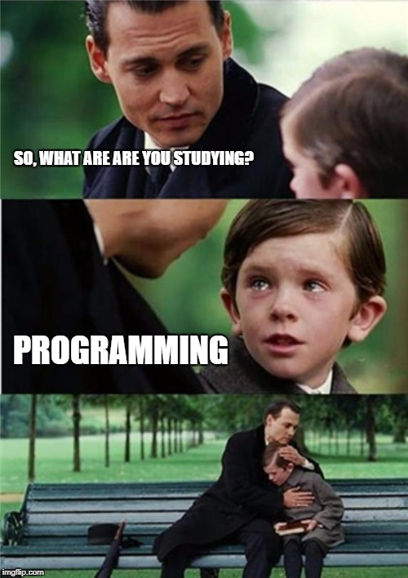
In this session…
Module Overview & Software versions
Introduction to Unity & C#
Unity folder structures
Adding scripts
Creating a first program
C# variables and methods
Creating a counting program
Creating an interactive interface in Unity
Many past their sell-by-date memes

Slide 5
Software versions
Unity version 2019.1.9f1
Visual Studio 2019
Please stick to using these versions, including at home, or you will find issues with moving work between home and University. Work submitted that doesn’t open in our version of Unity will not be marked.

Slide 6

What is Unity?
Unity is a cross-platform game engine developed by Unity technologies
Allows you to develop games for a huge number of different platforms, including all major PC operating systems and all major consoles
Uses the C# programming language, in conjunction with it’s own application programming interface (API), to allow games programming in a high-level language

Slide 7
What is C#?
C# is a high level, type-safe, just-in-time compiled programming language
It is the most commonly used language in the .NET language family
It is performant, and reasonably easy to learn for a language powerful enough to build games

Slide 8
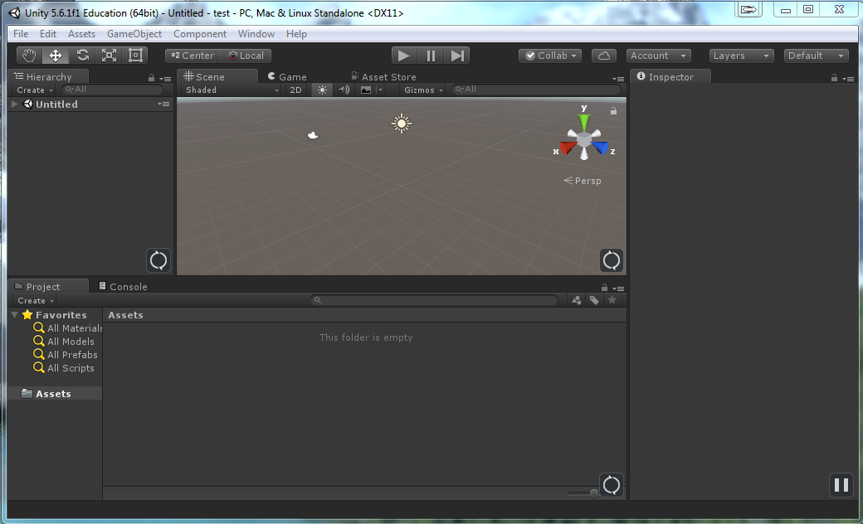
Introduction to Unity
Your Unity window should look like the image on the right
If not, click “Layout” and select “Default” to switch to the default layout

Slide 9
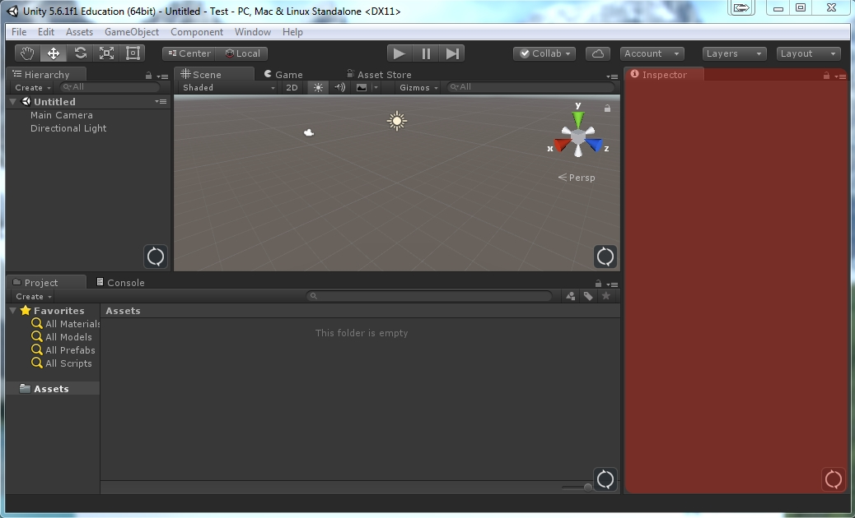
Unity - Inspector
Notes:
Shows options and information about the currently selected (in the hierarchy or the project window) game object

Slide 10
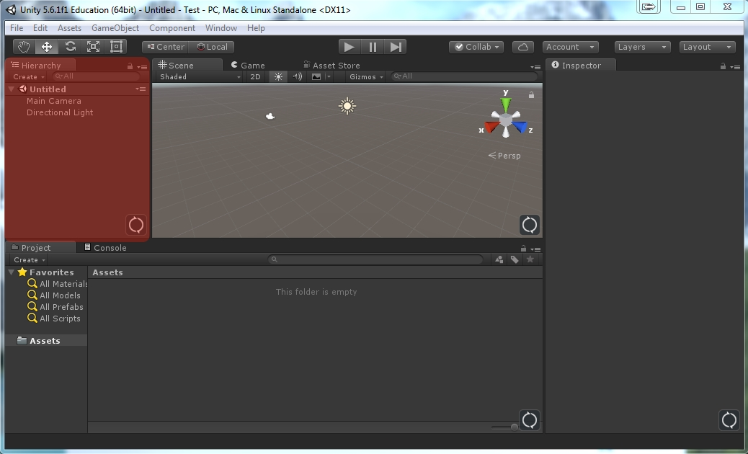
Unity – Heirarchy
Notes:
Show all objects in the current scene and how they relate to each other.

Slide 11
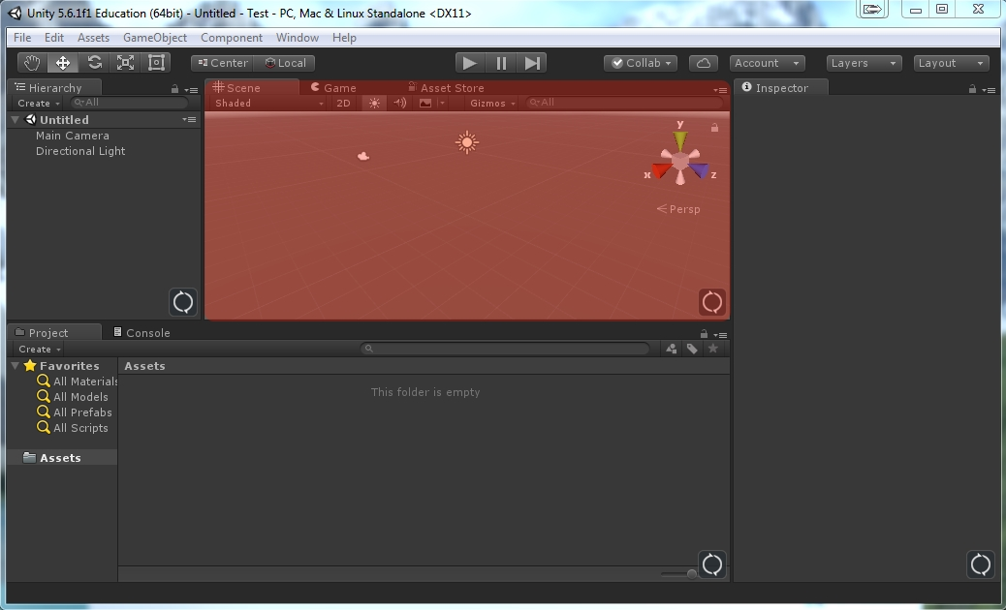
Unity - Scene
Notes:
Scene – displays a manipulatable representation of the current scene. Also note the game tab, switching to this will display a render of the current scene.

Slide 12
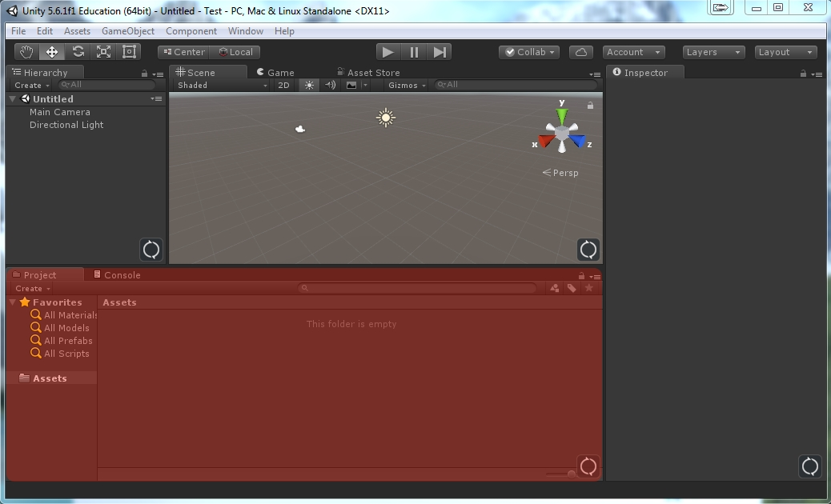
Unity - Project
Notes:
Project tab will show the current folder hierarchy on the disk, and allow you to select files and insert them into the current scene, load scenes, etc.
You should make an effort to create a sensible folder hierarchy to use for your Unity project.

Slide 13
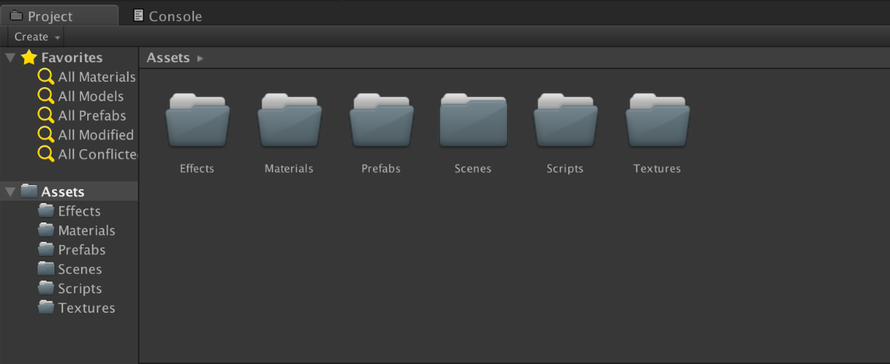
Unity folder structure
In the assets section of Unity, you can create a folder structure to contain the assets for your game
A sensible start would be to have top-level Scripts, Prefabs, Materials, Effects, Scenes & Textures folders
Then customise this with additional folders either at the top-level or lower in the hierarchy

Slide 14
Adding scripts
All scripts should be within the “scripts” folder, or sub-folders of this folder
Unity will create a Visual Studio project when you first add a script, and will keep this project up to date for you as you add scripts
When you create a script, Unity includes some default code, which we’ll now have a look at

Slide 15
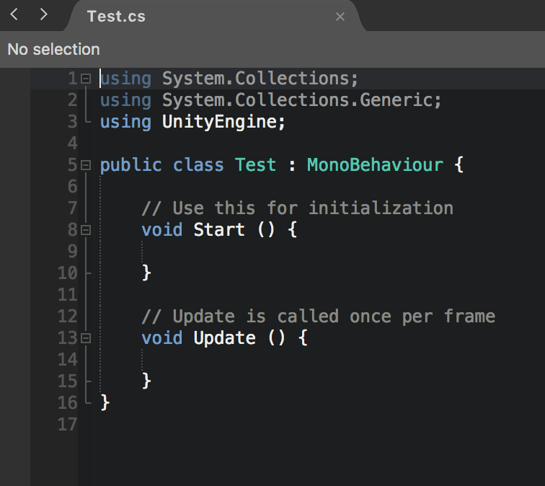
Using statements
The using statements at the top allow us to use parts of the Unity API and the .NET framework in our code

Slide 16
Class?
public class test : MonoBehaviour
A class is a “complex variable”
More on this later
This class “inherits” from MonoBehaviour, which for now, just think of as meaning you can use the functions and methods that MonoBehaviour supplies
Everything between the curly braces after the line with “class” is part of that class

Slide 17

Newly added script – methods/functions
A method/function is a chunk of code that can be run. It:
starts with a name
has a list of parameters between two brackets (or an empty pair of brackets)
The code that will be run is then between the two curly braces after the line with the method name
Start()
Will be called when a script is enabled, before any calls to update functions take place
Update()
Is called once every frame, when the script is enabled
For more information about other methods available to you, see:
https://docs.unity3d.com/2018.1/Documentation/ScriptReference/

Slide 18
Scripts and Gameobjects
Scripts have to be attached to a Unity game object, in order for the code in them to be called by the Unity engine
They also must be enabled – although by default they will be
Once some of your code has been called by the Unity engine, it can call other code that you have written – even if that code isn’t part of a game object – more on this later in the semester

Slide 19

Task #1 – Unity Hello World
Please start Unity, load the first video on moodle in a browser and follow along with that video to create a Unity Hello World program using C#
There may be minor differences as the video was created with an older version of Unity, but they should be manageable
Then modify this program so that a different message is displayed each time
When complete, save this project
Remember, real programmers use dark
mode in Visual Studio, never light mode
Just kidding – use whatever you like!

Slide 20

Analysis - What did I just write?
The “using” line we added tells C# that we are using code from this namespace (lets C# know what a “Text” object is)
The rest of our code is all in the “Start” method, which you’ll recall is called when a script is first loaded, provided it is enabled

Slide 21
Analysis - GetComponent
GetComponent<Type>() allows you to retrieve something of the appropriate type from the gameobject it is called on
If no object of the correct type exists, this function will return null, which is a special keyword in C#
If multiple items of the correct type exist, it will return the first found – there’s no way to be sure which this will be
GetComponents<Type>() can be used to retrieve all the components of the type in question, in a list
So because we have a “text” object we’ve added in Unity, GetComponent finds that and returns it
Once that’s been returned, we can access the values stored in it with a “.” operator, so we can change it’s “text” value, which changes the text displayed on screen

Slide 22
Analysis - Summary
Therefore, in our example we inserted our code in “Start()” and made sure the script was attached to an game object that existed in our current scene, so that the code will be run once when the scene loads
In our code, we used GetComponent<Text>() to get a reference to the UI.Text element we’d added in the Unity editor, to our game object
We then used the .text property of that UI.Text component, and set it to equal the string we wanted. This .text property sets the visible text for the UI.Text object

Slide 23
Variables
We’ve mentioned complex variables – what does that really mean?
Variables allow us to store information when we’re running our code and use it later
They let us assign a name to a location in memory, then store things in that location and refer to it by name
Simple variables are things like numbers, and strings (which is a programming term for text)

Slide 24
Types of Variable
Variables always have an associated type in C#
A variable declaration usually follows the format:
[type] [variable name] [= initial value];
I.e. int numberOfPeople = 12;
There are many allowed variable types in C#
The main ones you will use are “int” for whole numbers, “string” for text, like peoples names, float/double for numbers with decimal points (floating point numbers), and Boolean variables, for true/false values
In games programming, we mostly use floats for numbers with decimal points – they are less accurate than doubles but faster
Additionally you can create your own types, and name them, then use them to store data, these are complex types – the class that is by default created in a new unity script is one of these – this should make more sense later
Notes:
*There is such a thing as a dynamic variable, which still has an associated type, but the type is determined at run-time rather than at compile time. This is beyond the scope of this module, but worth noting as a concept that C# does support. Dynamic variables are best steered clear of unless they are a necessity, as you lose some of the benefits of type-safety.
For a full list of variable types available, see recommended reading, available on moodle

Slide 25
Integer variables
Integer variables store whole numbers
If you exceed the range in either direction, the variable will return to the other side. So for example, if you take a byte with a value of 255 and add 1, it will return to 0.
Type | Size | Range
int | 32 bit | -2147,483,648 to 2,147,483,647
uint | 32 bit | 0 to 4,294,967,295
byte | 8 bit | 0 to 255
long | 64 bit | -9,223,372,036,854,775,808 to 9,223,372,036,854,775,807

Slide 26
Floating point variables
There are two main different kinds of floating point variable, a float and a double
Because of the way that computers store numbers, it is not possible for floating point numbers to be infinitely accurate
Floats in C# are accurate to 7 digits, doubles are accurate to 16 digits
As mentioned, as games programmers we normally use floats rather than doubles

Slide 27
Boolean variables
Boolean variables can have a value of “true” or “false” which are keywords in C#
They are declared as a type “bool” and are useful for tracking things which you want to switch on and off

Slide 28
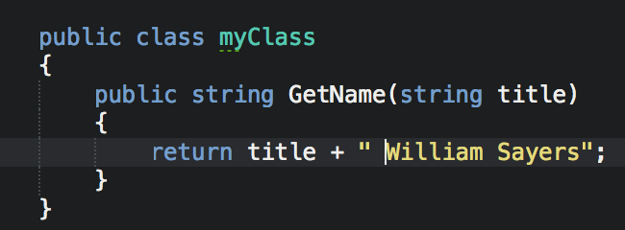
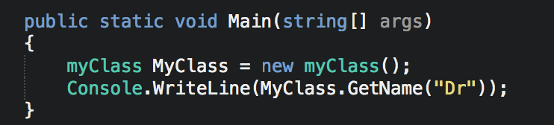
C# Methods
Methods in C# are a small section of code, with inputs, and outputs, which can be called from elsewhere in your code
They always live in classes or structs
They are declared and called as can be seen on the right

Slide 29
Task #2 – Counting in Unity
Please start Unity, load the second video on moodle in a browser and follow along with that video to create a counting program using C#
Then modify this program so that the count rapidity is increased
Then modify this program so that the count rapidity is decreased
When complete, save this project ready to use later

Slide 30
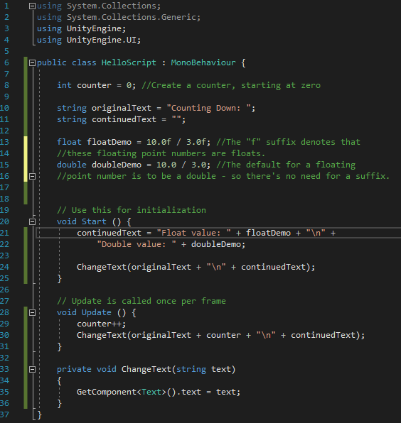
Analysis
We now have five extra variables, counter, originalText, continuedText, floatDemo and doubleDemo
Two of type string, one double, one float, one int
We’ve modified the Start() function to display our new text
continuedText is set to be equal to some descriptive text, plus the values from our variables
We then send our original text, plus continued text, as one string to ChangeText as a parameter
“\n” is code for insert a newline here
In the Update() function, we’re:
incrementing our counter by 1 (++ is a shortcut to do this)
Sending a combined string to ChangeText again, with the value of counter added in
”ChangeText” is a function we’ve created, which returns nothing (void) but sets the text for the text component

Slide 31
Responding to events in Unity
In simple terms, events are things that happen in Unity, that we may wish to respond to by running some special code, such as a button being clicked or text being entered
In order to respond to events in Unity, we need to create a method to be run when the event occurs
Then add it as an event handler in the Unity interface
This will allow us to do things in response to the user clicking a button, or interacting with controls in other ways
We will have a lot more on events later in the module

Slide 32
Task #3 Setting up an interactive UI
Please start Unity, load the third video on moodle in a browser and follow along with that video to create an interactive user interface in Unity
Then experiment with modifying this program as you wish (more buttons? Maybe one for hello, one for goodbye?)
When complete, save this project ready to use later

Slide 33
Resources
Unity Documentation (for the version in labs) is an invaluable resource, as Unity is very well documented. We cannot cover the entire Unity API in lectures, so you will need to use these resources yourself.
Unity Manual:
https://docs.unity3d.com/2019.1/Documentation/Manual/index.html
Scripting Reference:
https://docs.unity3d.com/2019.1/Documentation/ScriptReference/index.html

Slide 34

Any Questions?

Slide 35
Tutorial
Please load the tutorial video from Moodle, to complete a tutorial on creating a text-based adventure game
Feel free to customise this game as much as you like, adding rooms and changing text

